Slide 1

TOURISM MANAGEMENT
SYSTEM (TMS)

Slide 2

Team Members : I. Avinash (Y20IT041) G. Divya (Y20IT036) K. Kartheek (Y20IT045) Incharge : DR. M. Pompapathi

Slide 3

PROBLEM STATEMENT
This software is highly programmed in order to provide best services to customers and various travelling agents in the field of tourisms activities such as bookings, accommodations, tourism spot details. This integrated software offers one of the best ways of managing all the travel related businesses.
The user needs to visit travel agency office to plan any tour. It involves a lot of manual paperwork, and customers need to stay in the queue for a long time. The present systems are inadequate in providing information and advice to the agencies and customers about tour plans. Most of the time agencies have to rely on local information sources and on their experience regarding time and cost.

Slide 4
PROBLEM STATEMENT
The proposed system is highly automated and makes the travelling activities much easier and flexible. The user can get the very right information at the very right time. Customers can get the knowledge of the hotels and vehicles they are going to use in their trip prior to their starting of trip. The user gets complete information about the various tourist places based on users on their time, cost, source and destination places.
The user can do modifications within three days before of their start of journey, like:
Regarding the visiting places
Regarding the number of passengers
Regarding the hotel residencies

Slide 5
PROBLEM STATEMENT
User can also postpone or cancel their trip before a week and charges may apply to their according to their specification.

Slide 6
SYSTEM REQUIREMENT SPECIFICATION
ID | DETAILS | FUNCTIONALITIES | PRIORITIES
R1 | TMS must be able to store user information | Functional Data | Must have
R2 | TMS must be able to respond to user within seconds | Non-Functional performance | Must have
R3 | TMS must be able to validate login credentials of user | Functional | Must have
R4 | TMS must be able to display basic details of corresponding Admin/User when user logs in | Functional | Must have
R5 | TMS must be able to redirect to login page after registering in the system | Non-Functional | Must have

Slide 7
SYSTEM REQUIREMENT SPECIFICATION
R6 | TMS must be able to logout of the system | Functional | Must have
R7 | TMS must be able to provide user registration form | Functional | Must have
R8 | TMS must be able to provide user/admin login form | Functional | Could have
R9 | TMS must be able to store admin/user login information | Functional | Must have
R10 | TMS must be able to change the password of admin/user when requested | Functional | Must have

Slide 8
SYSTEM REQUIREMENT SPECIFICATION
R11 | TMS must be able to update profile of user when required | Functional | Must have
R12 | TMS must be able to provide information about tourist place to user | Functional | Must have
R13 | TMS must be able to postpone the user trip | Functional | Must have
R14 | TMS must be able to cancel the user trip | Functional | Must have
R15 | TMS must be able to generate the invoice of the trip | Functional | Should have

Slide 9
Software Requirements
Operating System : Windows XP
Coding Language : HTML, CSS,JAVASCRIPT,
Web Server : Flask Server(Python Module)
Data Base: MYSQL
Hardware Requirements
Personal computer with keyboard and mouse maintained with uninterrupted power supply.
Processor : Intel® core™ i3
Installed Memory (RAM) :4 .00 GB
Hard Disc : 40GB

Slide 10
Use Case Model
Use-case diagrams graphically represents system behavior (use cases). These diagrams present a high level view of how the system is used as viewed from an outsider’s (actor’s) perspective. A use-case diagram may contain all or some of the use cases of a system.
A use-case diagram can contain:
⦁ actors ("things" outside the system)
⦁ use cases (system boundaries identifying what the system should do)
⦁ interactions or relationships between actors and use cases in the system including the associations, dependencies, and generalizations.
Use-case diagrams can be used during analysis to capture the system requirements and to understand how the system should work. During the design phase, you can use use-case diagrams to specify the behavior of the system as implemented.

Slide 11
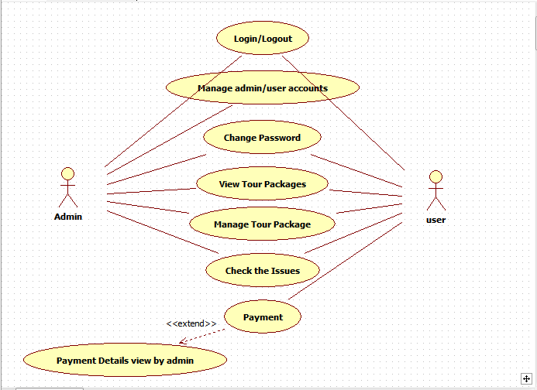
USE CASE DIAGRAM FOR TMS

Slide 12
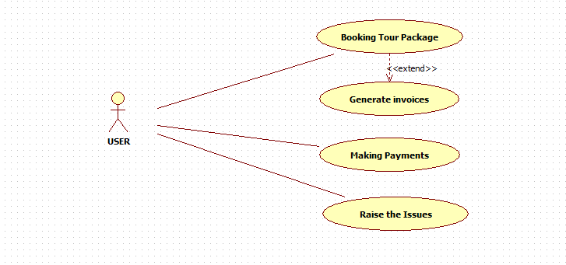

Slide 13
Activity Diagram
Activity diagrams are very similar to a flowchart because you can model a workflow from activity to activity. An activity diagram is basically a special case of a state machine in which most of the states are activities and most of the transitions are implicitly triggered by completion of the actions in the source activities.
Activity Diagrams also may be created at this stage in the life cycle. These diagrams represent the dynamics of the system. They are flow charts that are used to show the workflow of a system; that is, they show the flow of control from activity to activity in the system, what activities can be done in parallel, and any alternate paths through the flow.
At this point in the life cycle, activity diagrams may be created to represent the flow across use cases or they may be created to represent the flow within a particular use case.
Later in the life cycle, activity diagrams may be created to show the workflow for an operation.

Slide 14
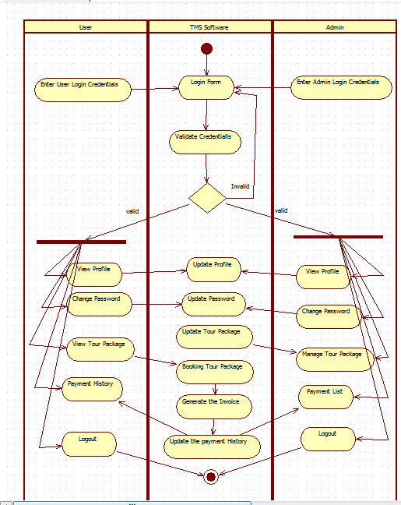
Activity Diagram For Admin And User

Slide 15
Sequence Diagram
A sequence diagram is a graphical view of a scenario that shows object interaction in a timebased sequence--what happens first, what happens next…
Sequence diagrams establish the roles of objects and help provide essential information to determine class responsibilities and interfaces.
A sequence diagram has two dimensions: the vertical dimension represents time; the horizontal dimension represents different objects. The vertical line is called the object’s lifeline. The lifeline represents the object’s existence during the interaction.
ELEMENTS OF SEQUENCE DIAGRAM:
⦁ Objects
⦁ Links
⦁ Messages
⦁ Focus of control
⦁ Object life line

Slide 16
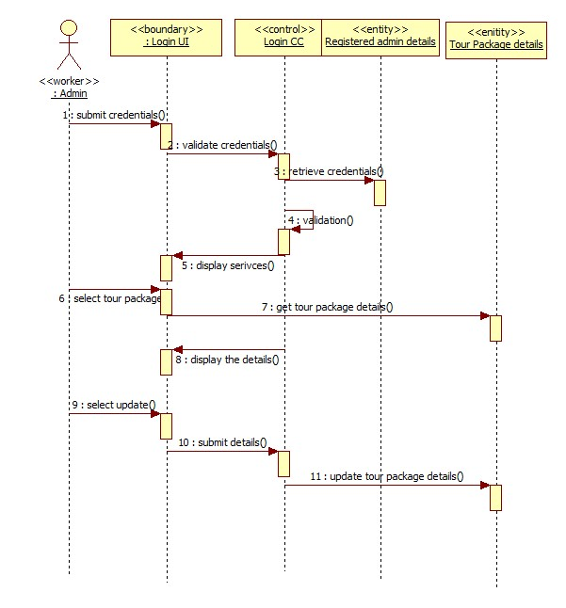
Sequence Diagram for Managing Tour Packages by Admin

Slide 17
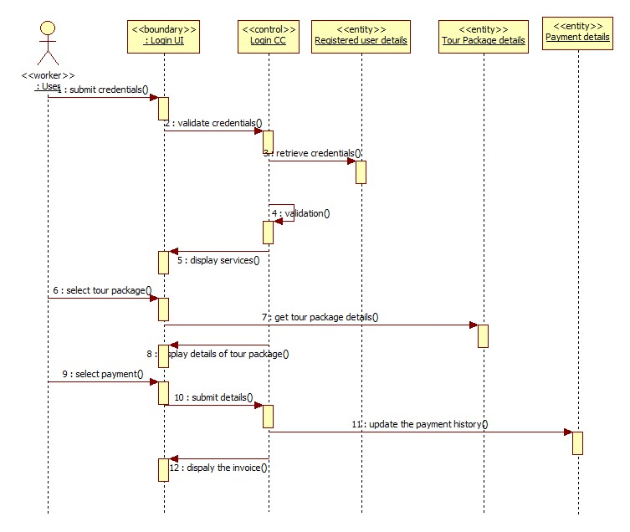
Sequence Diagram for Making Payment by User

Slide 18
Collaboration Diagram
Collaboration diagrams are the second kind of interaction diagram in the UML diagrams. They are used to represent the collaboration that realizes a use case. The most significant difference between the two types of interaction diagram is that a collaboration diagram explicitly shows the links between the objects that participate in a collaboration , as in sequence diagrams, there is no explicit time dimension.

Slide 19
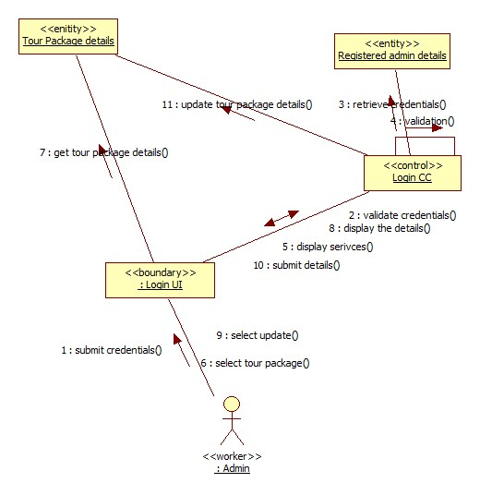
Collaboration Diagram for Managing Tour Packages by Admin

Slide 20
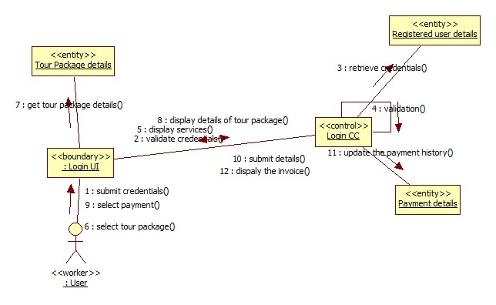
Collaboration Diagram for Making Payment by User

Slide 21

Class Diagram
Class diagrams contain icons representing classes, packages, interfaces, and their relationships. You can create one or more class diagrams to depict the classes at the top level of the current model; such class diagrams are themselves contained by the top level of the current model.
Class:
A Class a description of a group of objects with common properties (attributes), common behavior (operations), common relationships to other objects, and common semantics.
Thus, a class is a template to create objects. Each object is an instance of some class and objects cannot be instances of more than one class. Classes should be named using the vocabulary of the domain.
In the UML, classes are represented as compartmentalized rectangles.
The top compartment contains the name of the class.
The middle compartment contains the structure of the class (attributes).
The bottom compartment contains the behavior of the class (operations) .

Slide 22
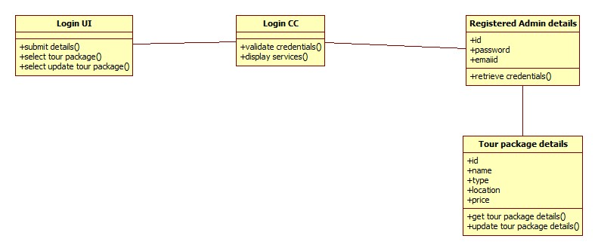
Class Diagram For Managing Tour Packages by Admin

Slide 23
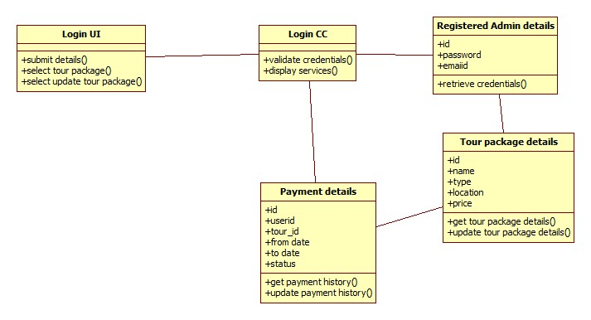
Class Diagram For Making Payment

Slide 24
State Chart Model
Use cases and scenarios provide a way to describe system behavior; in the form of
interaction between objects in the system. Sometimes it is necessary to consider
inside behavior of an object.
A state chart diagram shows the states of a single object, the events or messages
that cause a transition from one state to another, and the actions that result from a
state change. As in Activity diagram , state chart diagram also contains special
symbols for start state and stop state.
State chart diagram cannot be created for every class in the system , it is only for those class objects with significant behavior.
State chart diagrams are closely related to activity diagrams. The main difference between the two diagrams is state chart diagrams are state centric, while activity diagrams are activity centric. A state chart diagram is typically used to model the discrete stages of an object’s lifetime, whereas an activity diagram is better suited to model the sequence of activities in a process.

Slide 25
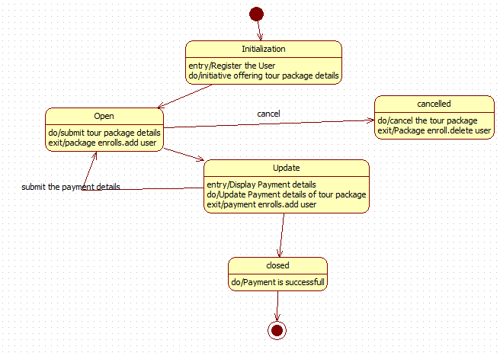
State Chart Diagram For Making Payment

Slide 26
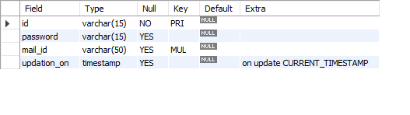
Database Tables Created in Application
Admin Table
ADMIN Table stores details of admins.

Slide 27
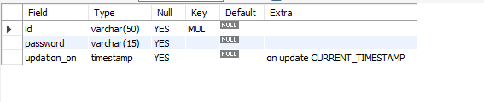
User Table
USERS table store the details of users.

Slide 28
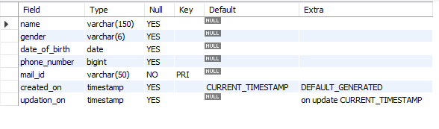
Person Table
PERSON Table stores personal details of admin and user

Slide 29
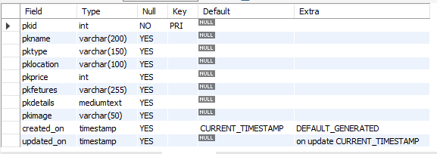
Tour Package details
TOUR PACKAGES Table stores details of different tour packages.

Slide 30
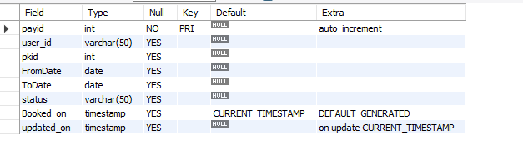
PAYMENT TABLE
PAYMENT Table stores the details of user , tour package, from date and end date.

Slide 31
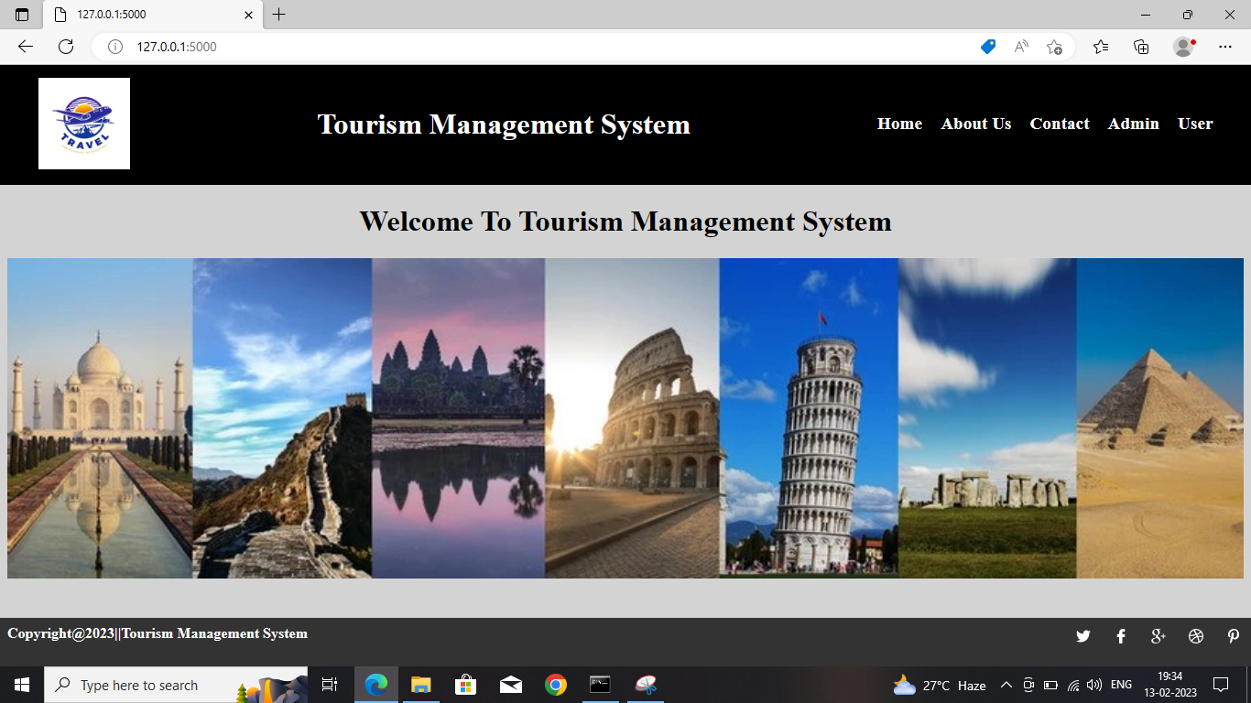
APPLICATION IMPLEMENTATION SCREENSHOTS

Slide 32
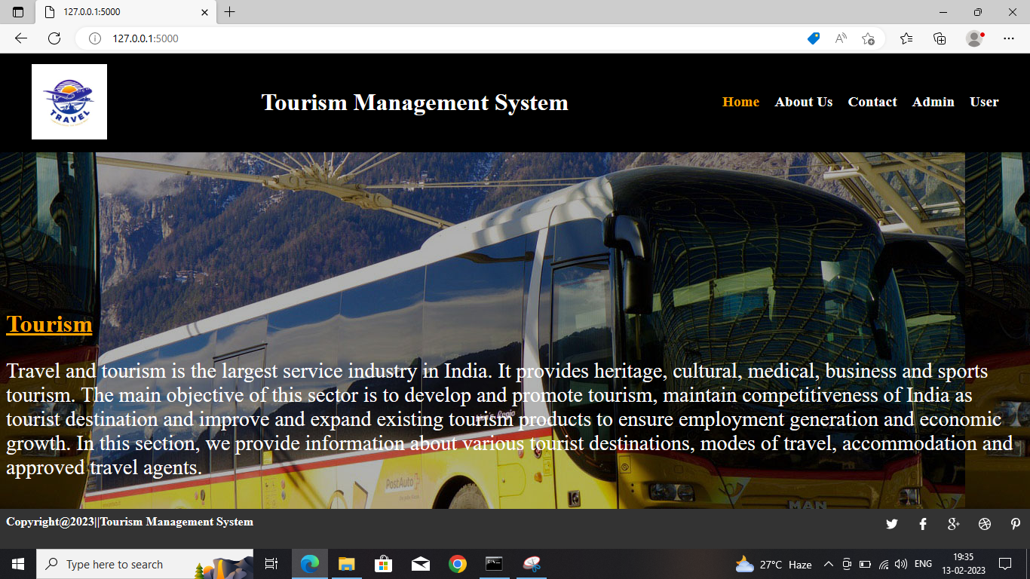
HOME PAGE

Slide 33
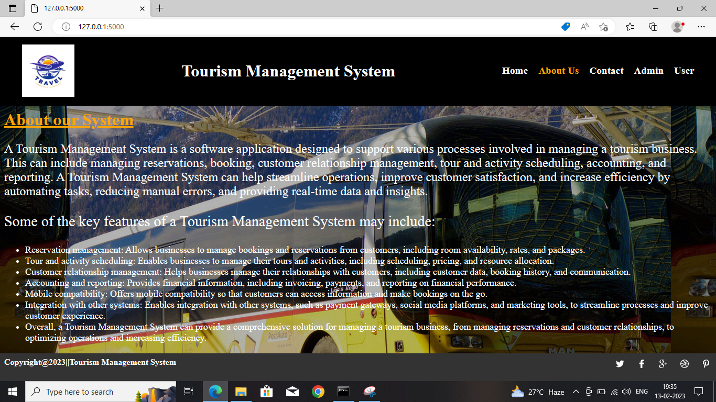
ABOUT US PAGE

Slide 34
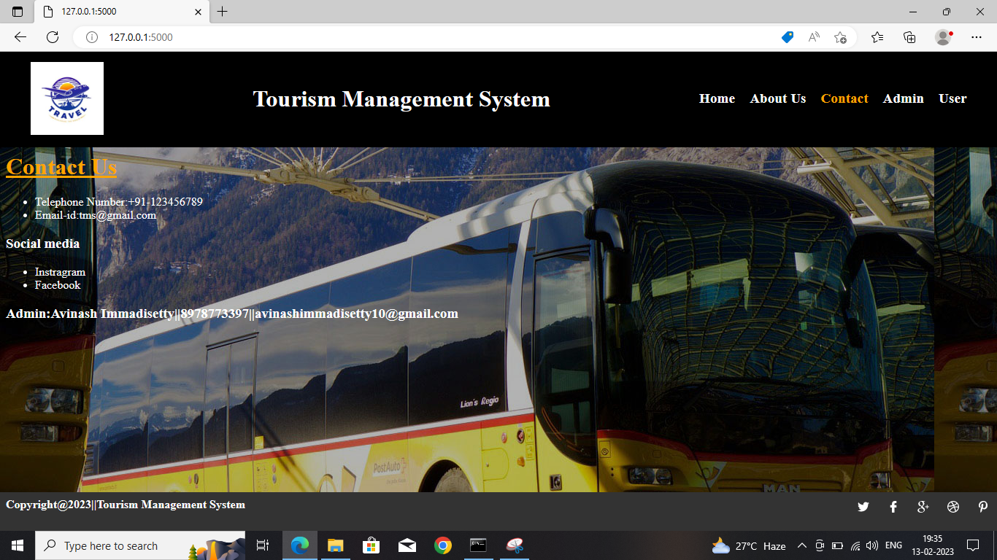
CONTACT PAGE

Slide 35
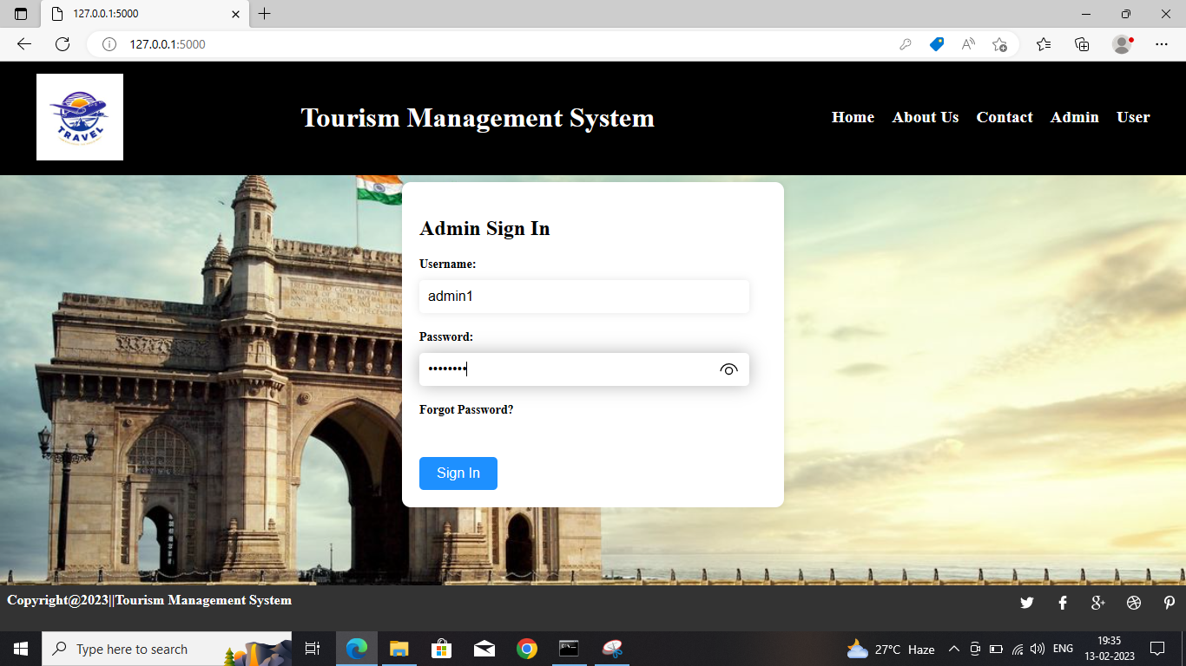
LOGIN FORM

Slide 36
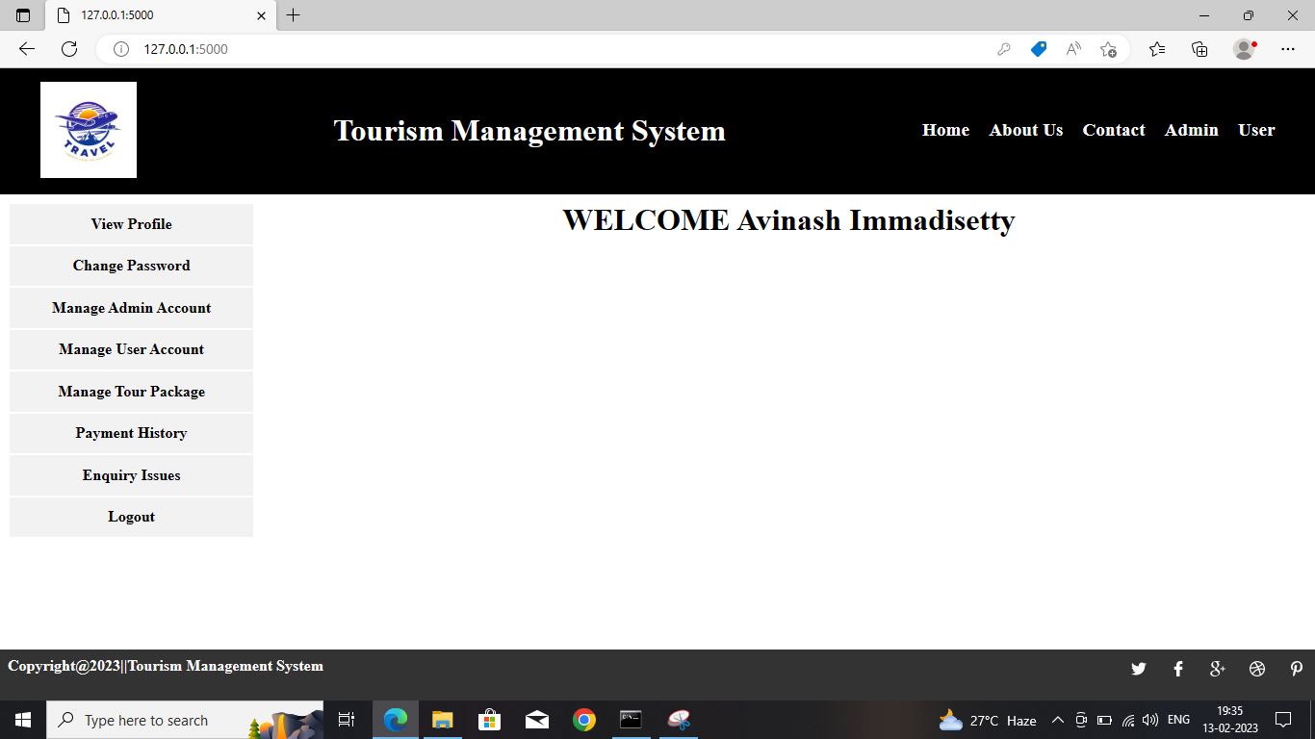
AFTER LOGIN

Slide 37
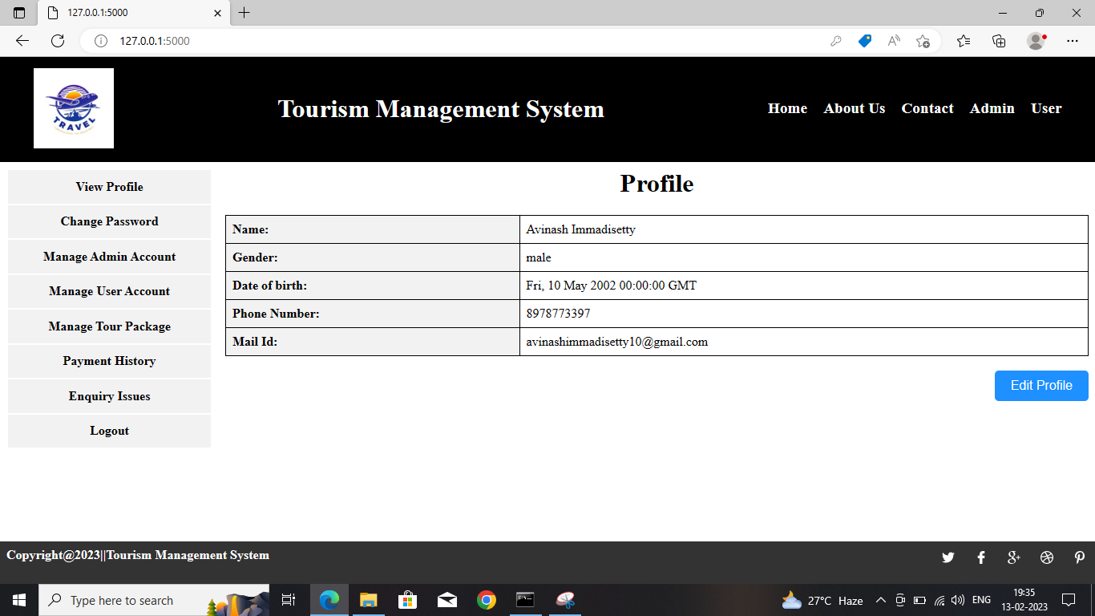
VIEW PROFILE

Slide 38
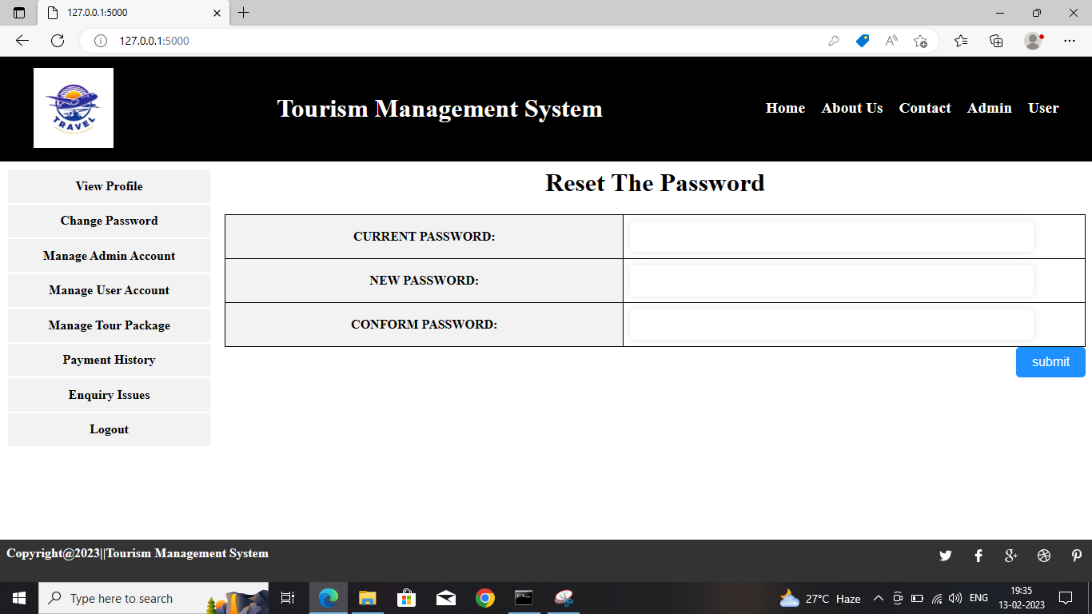
CHANGE PASSWORD

Slide 39
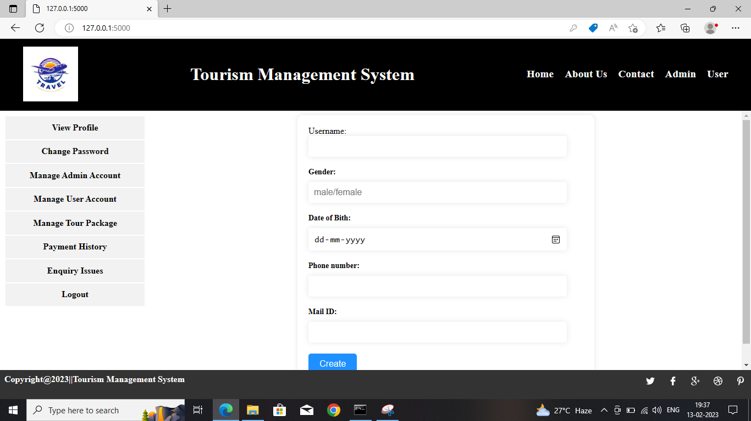
REGISTER FORM

Slide 40
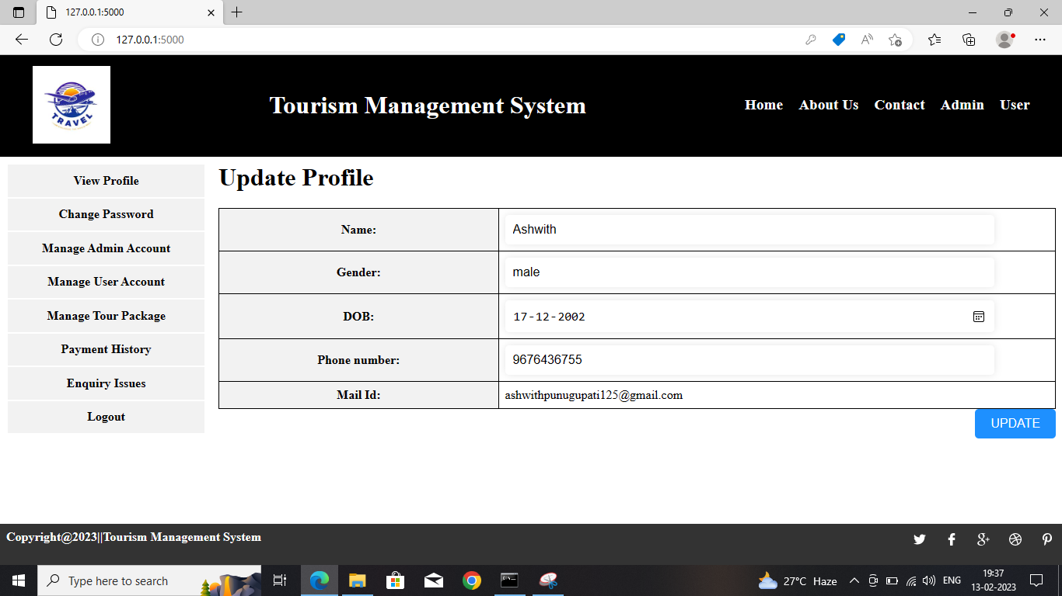
UPDATE PROFILE

Slide 41
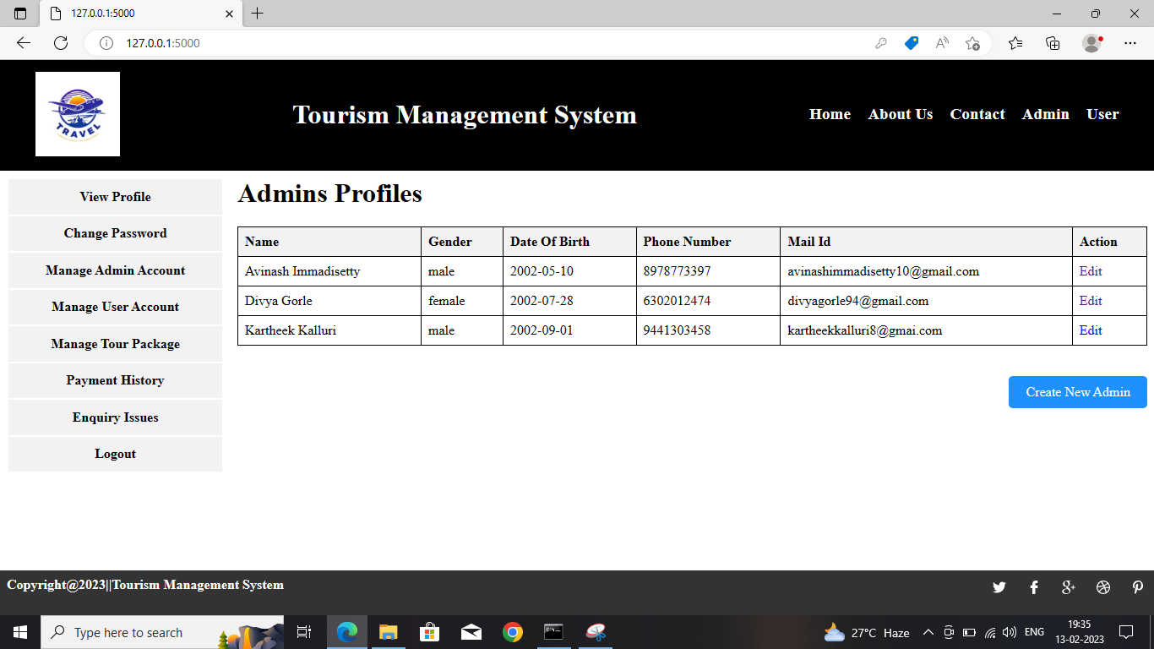
MANAGE ADMIN PROFILES

Slide 42
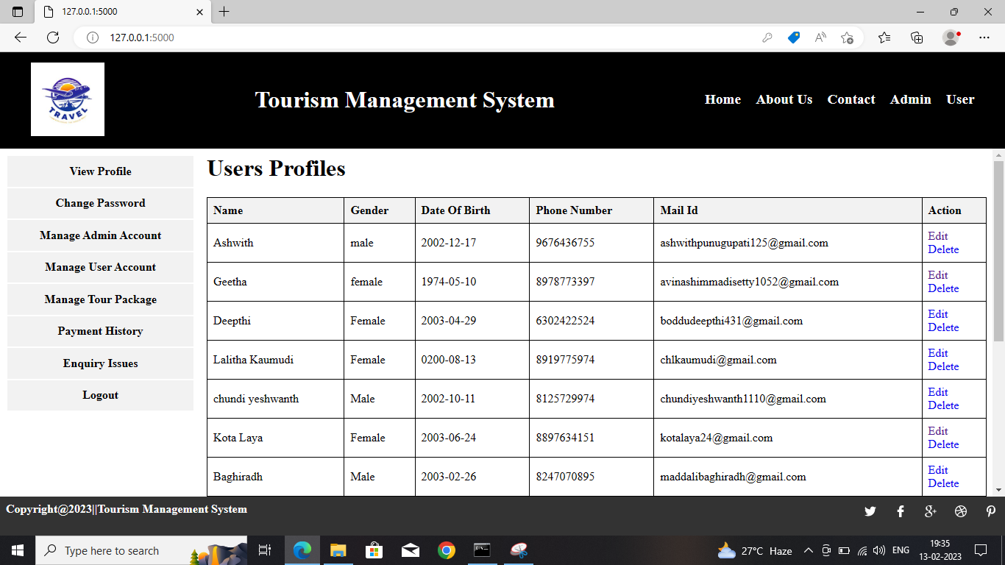
MANAGE USER PROFILES

Slide 43
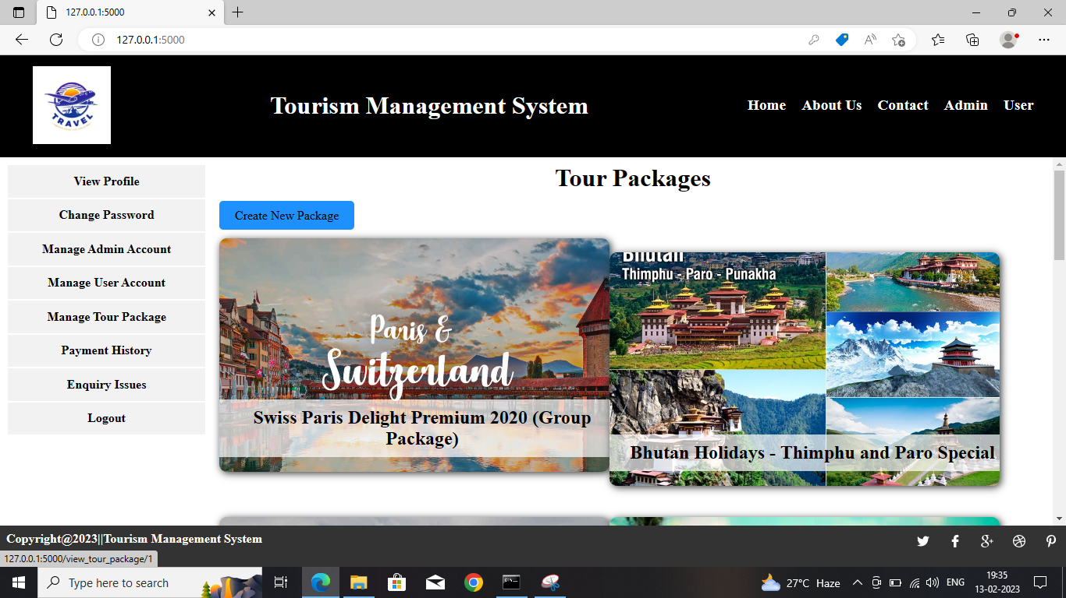
DISPLAY TOUR PACKAGES

Slide 44
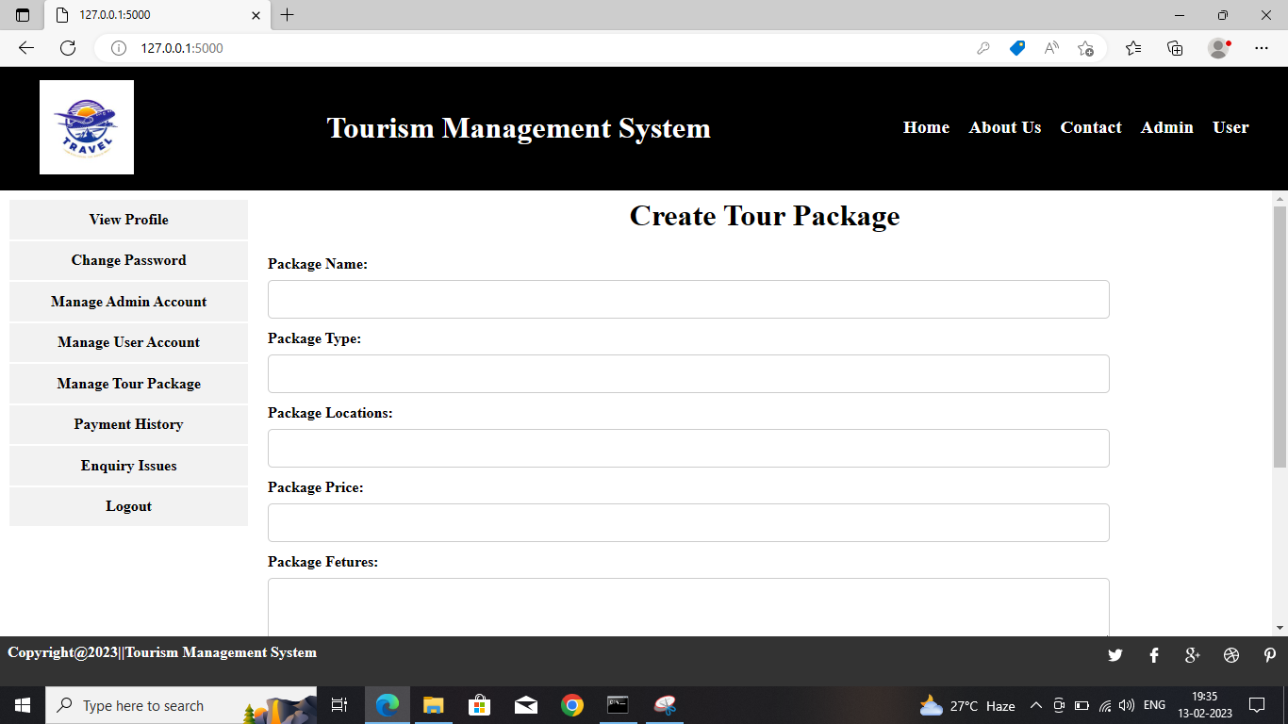
CREATE NEW TOUR PACKAGE

Slide 45
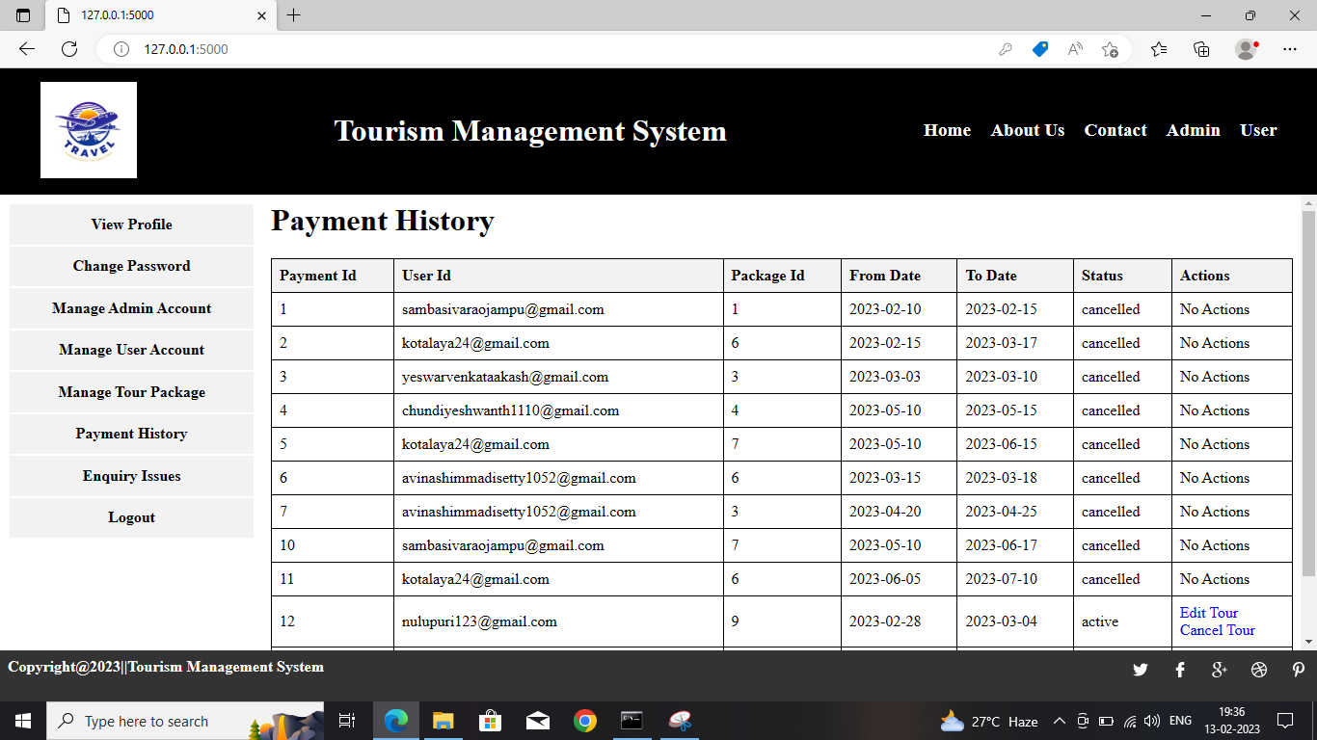
PAYMENT HISTORY

Slide 46
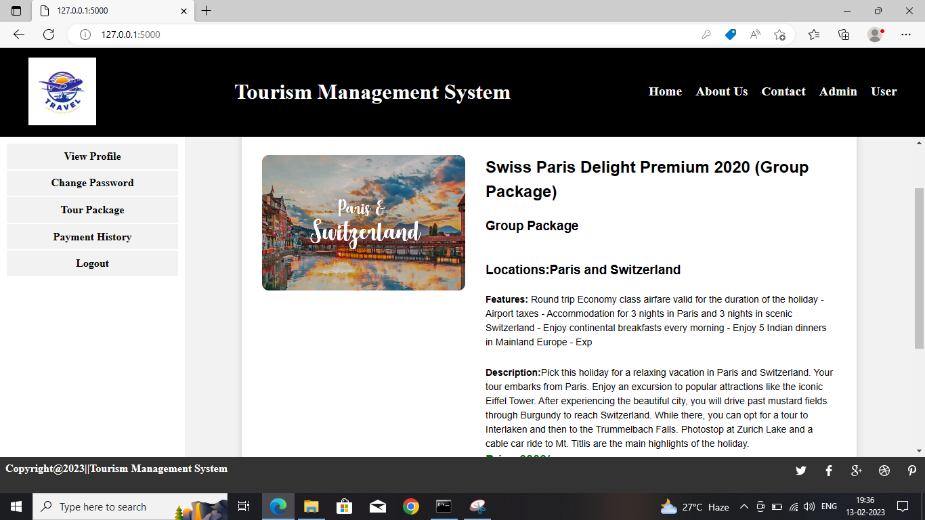
DISPLAY DETAILS OF SELECTED TOUR PACKAGE

Slide 47
CONCLUSION
TOURISM MANAGEMENT SYSTEM is the system that facilitates the user to book the tour package for their trip. This system saves time and energy for both user and admin. This proposed system can be developed in gives suggestion about tourism places that user can visit. The aim of the project entails the design and implementation of a platform that will assist tourists in gaining access to travel to various tourist locations. For a modified system, the user need to just login into the application and can find the routes, cost, hotels, transportations and book immediately and complete the booking process for a successful transaction.

Slide 48
REFERENCES
Harvey M. Deitel and Paul J.Deitel, "Internet & World Wide Web How to Program", 4/e, Pearson Education.
Jason Cranford Teague "Visual Quick Start Guide CSS, DHTML & AJAX", 4/ e, "Pearson Education".
Roger S. Pressman, Software Engineering - A Practitioner's Approach, Seventh Edition, McGraw Hill Publications.
Software Engineering Resources : - www.rspa.com/spi/ • Database Systems, Ramez Elmasri and Shamkant B.Navathe, Pearson Education, 6th edition.
James Rumbaugh, Jacobson, Booch, Unified Modeling Language Reference Manual, 2nd Edition, PHI.

Slide 49


Slide 50


